Slide 1


The redox properties of coordination compounds
Al-Farabi Kazakh National University
Faculty of Chemistry and Chemical technology
Department of General and Inorganic Chemistry
PhD Bakhadur Askar

Slide 2

Redox behavior in coordination compounds
Redox processes in coordination chemistry involve electron transfer between a metal center and other chemical species. In these reactions, the oxidation state of the central metal ion changes, while the ligands or other components may act as electron donors or acceptors.
Coordination compounds are ideal systems for studying redox reactions because the metal center is embedded in a well-defined environment of ligands that can stabilize various oxidation states. This allows for the observation of reversible oxidation–reduction cycles, which are crucial in catalysis, energy conversion, and biochemical processes.
Redox-active complexes play vital roles in systems such as photosynthesis, cellular respiration, and industrial oxidation reactions.

Slide 3

Oxidation states and electron transfer
The oxidation state of a metal ion defines its ability to gain or lose electrons. For a coordination compound, it is determined by the formal charge on the metal and the nature of its ligands.
During redox reactions:
$$\left[Fe\left(H_{2}O{\left.)\right.}_{6}{\left.]\right.}^{2+}→\left[Fe\left(H_{2}O{\left.)\right.}_{6}{\left.]\right.}^{3+}+e^{−}\right.\right.\right.\right.$$
the iron ion is oxidized, while in the reverse process it is reduced.
Electron transfer can occur within the same complex or between different complexes. The range of accessible oxidation states depends on:
The electronic configuration of the metal,
The strength and type of ligands, and
The overall stability of the resulting species.
Transition metals, due to their variable d-orbital occupancy, are particularly suited to redox transformations.

Slide 4


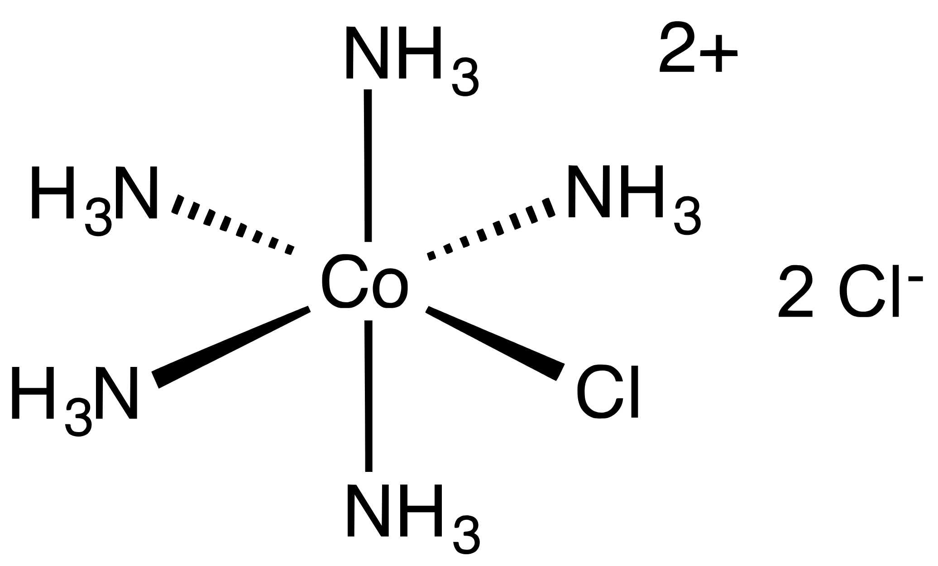

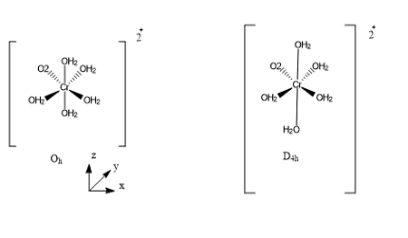

Inner-sphere and outer-sphere redox mechanisms
Redox reactions in coordination chemistry generally occur through two main mechanisms:
1. Inner-Sphere Mechanism:
Involves the formation of a bridging ligand that connects the oxidant and the reductant.
Electron transfer occurs through this shared ligand. Example: the reaction between $\left[Co\left(NH_{3}{\left.)\right.}_{5}Cl{\left.]\right.}^{2+}\right.\right.$and $\left[Cr\left(H_{2}O{\left.)\right.}_{6}{\left.]\right.}^{2+}\right.\right.$, where the chloride ligand temporarily bridges the two metal centers.
2. Outer-Sphere Mechanism:
The coordination spheres of the reactants remain intact.
Electron transfer occurs through electronic coupling across the solvent or space, without direct bond formation.
The distinction between these mechanisms helps explain variations in reaction rates, activation energies, and redox potentials.

Slide 5
Factors influencing redox potential
Metal Ion Nature: Metals with higher nuclear charge and smaller radius generally have higher oxidation potentials.
Ligand Type: Ligands that are strong field (according to the spectrochemical series) stabilize higher oxidation states and raise redox potential.
Solvent Effects: Solvent polarity and dielectric constant affect ion stabilization and electron transfer efficiency.
pH Dependence: Protonation or deprotonation of coordinated ligands can alter electron density on the metal center, shifting the potential.
Coordination Geometry: Geometric strain and symmetry influence orbital overlap, thereby modifying the ease of electron transfer.

Slide 6
Ligand effects and electronic structure
Ligands play a central role in tuning the electronic properties and redox reactivity of coordination compounds.
π-Acceptor ligands (such as CO, CN⁻) stabilize low oxidation states by back-donation of electron density from the metal’s d-orbitals.
π-Donor ligands (such as halides or oxides) favor higher oxidation states by donating additional electron density to the metal.
σ-Donor ligands (like NH₃ or H₂O) influence the field strength and control the energy splitting of d-orbitals, indirectly affecting redox potential.
By selecting specific ligands, chemists can fine-tune the redox properties of a metal complex, enabling controlled catalysis, selective electron transfer, and efficient redox cycling in synthetic and biological systems.

Slide 7
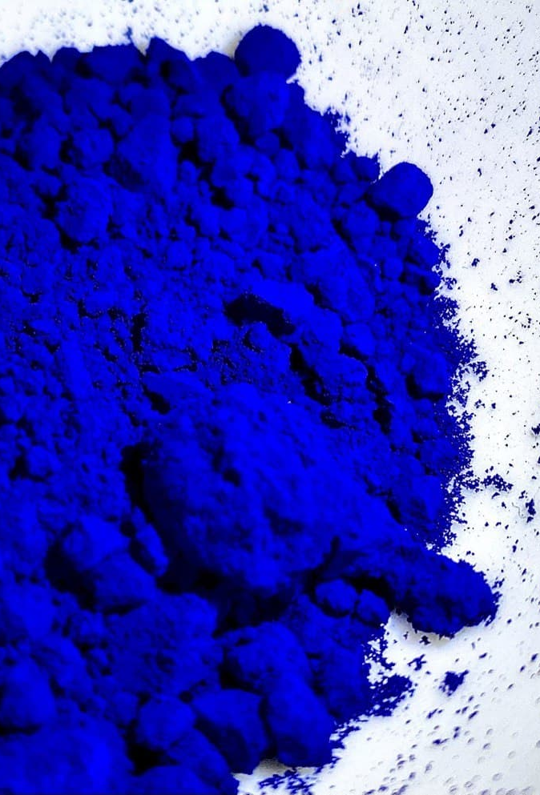

Mixed-valence complexes
Mixed-valence compounds contain metal centers in different oxidation states within the same molecule or lattice. These species exhibit unique electronic and spectroscopic properties because of delocalized electron transfer between metal sites.
A classic example is Prussian blue, $\left[Fe_{4}^{III}\left[Fe^{II}\left(CN{\left.)\right.}_{6}{\left.]\right.}_{3}\right]\right.\right.$, which owes its deep blue color to intervalence charge transfer between Fe(II) and Fe(III) centers.
Mixed-valence complexes are important in understanding electron delocalization, conductivity, and magnetic properties in coordination networks. They also serve as models for biological redox systems and molecular electronics.
The extent of electron delocalization depends on the distance between metal centers, orbital overlap, and bridging ligand properties.

Slide 8

Applications in catalysis and electrochemistry
Redox-active coordination compounds are fundamental in both industrial and biological processes.
In catalysis, complexes of metals like ruthenium, cobalt, and platinum mediate electron transfer in oxidation and reduction reactions, including hydrogenation and water splitting.
In electrochemistry, complexes such as $\left[Fe\left(CN{\left.)\right.}_{6}{\left.]\right.}^{3−/4−}\right.\right.$are used as redox mediators in sensors and energy storage systems.
Bioinorganic redox systems, such as cytochromes and iron–sulfur clusters, demonstrate nature’s ability to control redox chemistry through precise coordination environments.
By understanding the redox mechanisms and equilibria of coordination compounds, chemists design efficient and sustainable redox systems for energy conversion, environmental remediation, and chemical manufacturing.

Slide 9
Summary
Redox properties of coordination compounds involve electron transfer between metal centers and surrounding species.
Oxidation and reduction processes are governed by metal oxidation states, ligand field effects, and solution environment.
Inner- and outer-sphere mechanisms define the pathways through which electrons move.
Ligands play a decisive role in stabilizing oxidation states and tuning redox potentials.
Mixed-valence complexes exhibit unique electronic behavior due to delocalized charge transfer.
Applications span catalysis, bioinorganic chemistry, and electrochemical technologies.
The redox behavior of coordination compounds reveals the intricate relationship between electronic structure, ligand environment, and chemical reactivity. Through careful design and understanding of these systems, chemists can harness redox processes for applications in catalysis, energy, and biology, bridging the gap between molecular and materials chemistry.

Slide 10
Thank you for attention!

